Slide 1
Kai Hwang : Cloud Computing for Machine Learning and Cognitive Applications The MIT Press, June 2017 Chapter 10: Cloud Benchmark Performance, Security and Data Privacy Solutions (60 Slides for 3-hour lectures) All rights reserved by Kai Hwang and MIT Press, 2017. For exclusive use by qualified instructors adopting the textbook, not for commercial or publication release

Slide 2
Cloud Performance Issues
1) Scaling measurement: Cloud scaling is done with virtualized resources. Hence, the scale of computing power is decided at various abstraction levels of virtual resources
2) Workload scenario: Cloud aims to accommodate workload with large number of small jobs. Scaling strategies must match with such a workload scenario

Slide 3
Cloud Performance Issues
3) Performance attributes: To benefit a large number of small jobs, performance concerns are the response time and throughput, rather than batch execution time
4) Cloud productivity: Productivity is tied to performance cost ratio. Tradeoffs do exist in high performance versus service costs to massive users

Slide 4
Scale-Out Workloads
Cloud workloads are characterized by their dataset size, algorithms, memory-access pattern, and service model applied. Scaling techniques cover three cloud workload types:
Scale-out technique allows adding more machine instances or processing nodes of the same type based on the quota agreed in the service-level agreement (SLA). Obviously, scaling out appeals more to the use of homogeneous clusters with identical nodes.

Slide 5
Scale-Up and Mixed Workloads
Scale-up technique is implemented with scaling the cloud from using small nodes to more powerful nodes equipped with better processor, memory or storage.
Mixed scale-up/scale-out technique allows one to scale up or scale-down the instance type and adjust the instance quantity by scale-out (increasing) or scale-in (reducing) resources at the same time. Mixed scaling appeals better with using heterogeneous clusters.

Slide 6
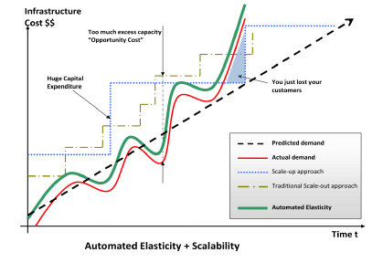
Understanding Elasticity in Cloud Resources
Notes:
You all know about Amazon. You may not be aware of the early success we’re seeing with our AWS business.
6

Slide 7
Elastic Cloud Resources Provisioning for High Throughput Performance

Slide 8
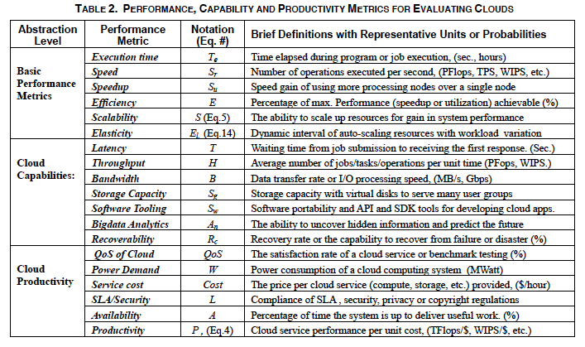

Slide 9
Basic Performance Metrics
Speed (S): Number of millions of operations per second (Mops). The operation could be integer or floating-point like MFlops. The speed is also called throughput such as millions of web interactions per second (MIPS), etc.
Speedup (S_{u}): Speed gain of using multiple nodes
Efficiency (E_{f}): Percentage of peak performance achieved
Utilization (U): Busy resources (CPU, memory, storage)
Scalability (S): Scaling ability to upgrade performance

Slide 10
Cloud Capabilities are macroscopic metrics
Latency (L): System response time or access latency
Bandwidth (B): This is data transfer rate or I/O rate
Elasticity (E_{l} ): The ability for cloud resources to scale up/down or scale in/out to match with workload variation
Software (S_{w}): Software portability, API and SDK tooling
Big-data Analytics:(A_{n}): The ability to uncover hidden information or predict trends in big data

Slide 11
.Cloud Productivity Measures
Quality of Service (QoS): Satisfaction on user services
System availability (A): The system up time per year
Service costs (C_{o}): User renting costs and provider cost
Power Demand (W): Cloud power consumption (MWatt)
SLA/Security (L): Compliance of SLA, security, etc.
Productivity (P): QoS-satisfied perf. per unit cost

Slide 12
Elasticity Analysis of Scalable Cloud Performance
Elasticity refers to the stretchability of cloud resources like CPU power, storage capacity, etc.
Elasticity is measured by the speed (or overhead) to reconfigure the cloud configuration
Elastic resource provisioning cannot not be done with physical machine, only virtual machines can be refigured in real-time

Slide 13
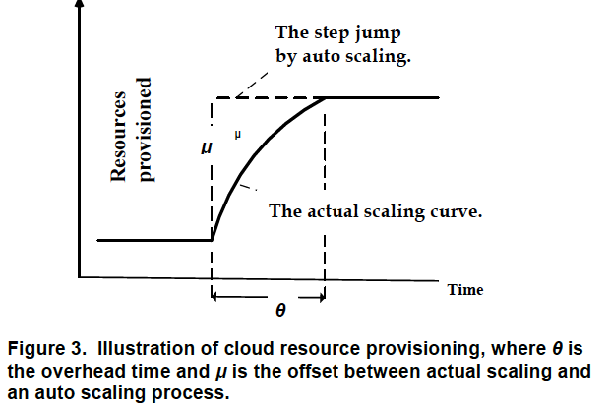

Slide 14
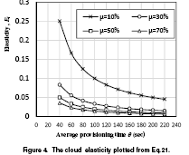
Cloud Elasticity Analysis (cont’d)

Slide 15
Elastic Compute Unit (ECU)
Amazon AWS has defined a term: Elastic (or EC2) Compute Unit (ECU) as an abstract unit to quantify the computing capacity of a machine instance type
By 2009 standard, the performance of a 1 ECU instance is roughly equivalent to the CPU capacity of a 1.2 GHz 2007 Xeon processor
Each physical CPU (processor) can house a number a number of virtual CPU (vCPU). Also the memory and storage may affect the ECU count

Slide 16
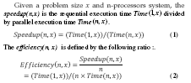
Performance Metrics: Speedup and Efficiency

Slide 17
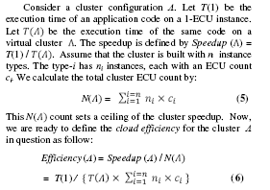
Cloud Efficiency for Different EC2 Configurations

Slide 18
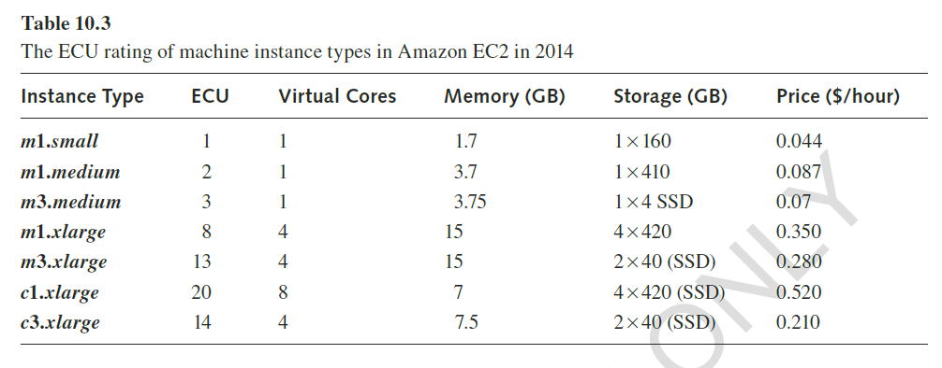

Slide 19
Cloud Efficiency for Different EC2 Configurations

Slide 20
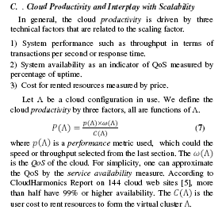
Cloud Productivity

Slide 21
Cloud Productivity

Slide 22
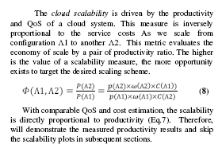
Cloud Scalability

Slide 23
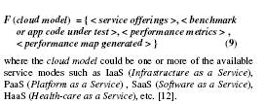
A Generic Cloud Performance Model

Slide 24
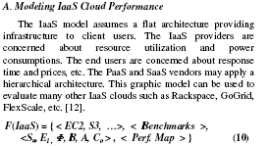
Lecture 15: Oct. 11, 2017 Cloud Performance Modeling

Slide 25
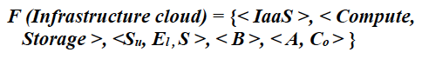
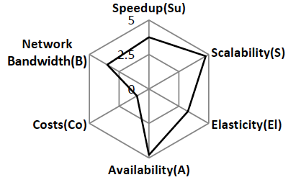
IaaS Cloud Performance Model

Slide 26
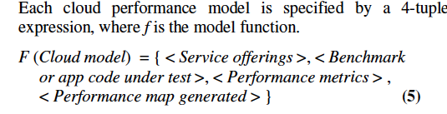
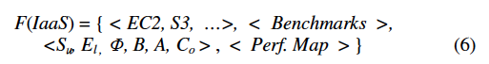

Slide 27
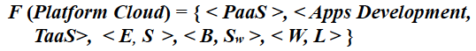
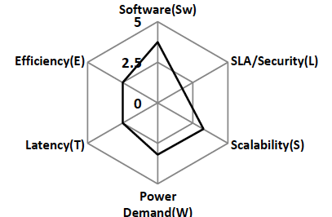
PaaS Cloud Performance Model

Slide 28
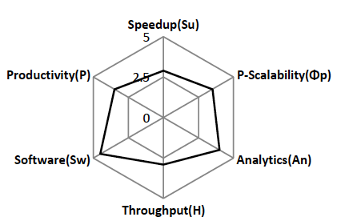
SaaS Cloud Pereformance Model

Slide 29
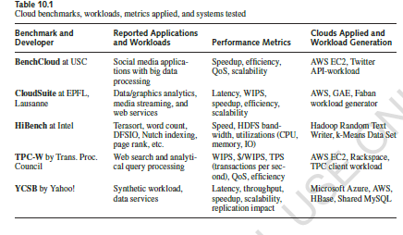
Cloud Benchmarks

Slide 30
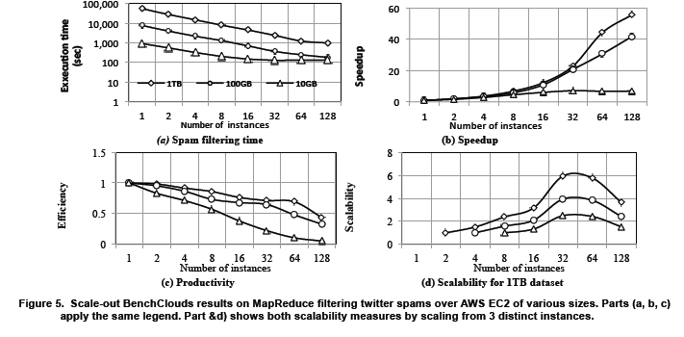
Twitter Spam Filtering Results on EC2

Slide 31
Twitter Spam Filtering on EC2

Slide 32
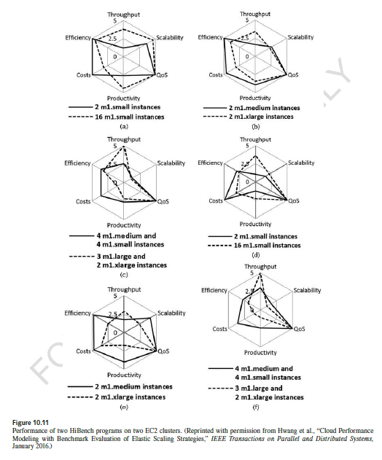
Scale-Out Performance on EC2

Slide 33
Scale-Up Performance on EC2

Slide 34
Cloud Performance for Mixed Workload

Slide 35
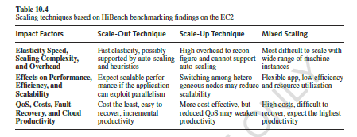

Slide 36
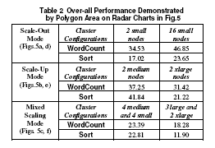

Slide 37
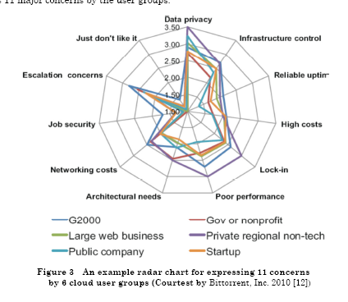
March 5, 2012

Slide 38
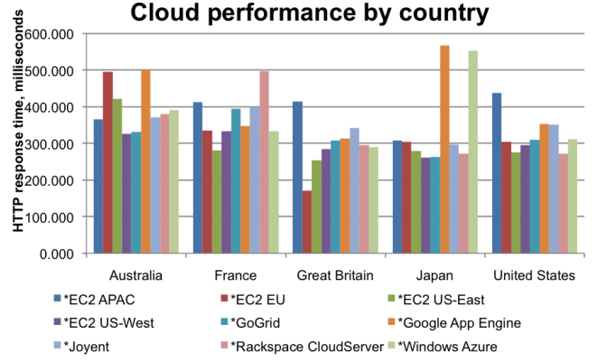

Slide 39
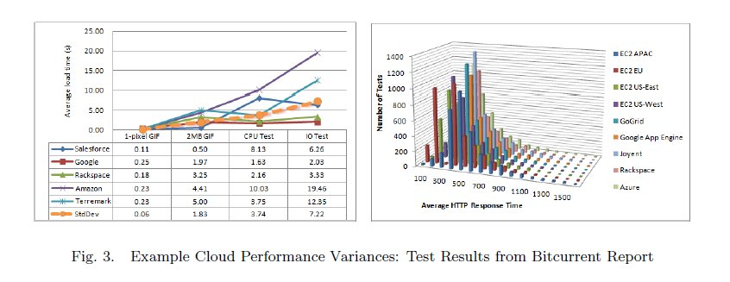
Average response times in ms of 9 cloud service reported in Bitcurrent Report (Courtesy of A. Croll [27])
March 5, 2012

Slide 40
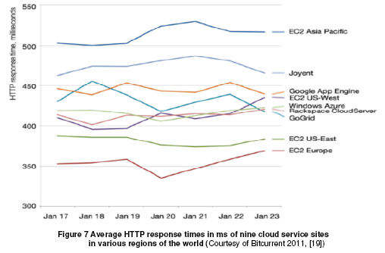
HTTP Response Time of Working Clouds

Slide 41
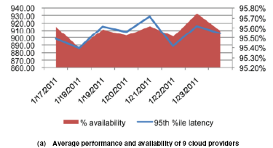

Slide 42
Cyber Security Threats
Loss of
Confidentiality
Loss of
Integrity
Loss of
Availability
Improper
Authentication
Information
Leakage
Integrity
Violation
Denial of
Service
Illegitimate
Use
Dos
Trojan Horse
Trapdoor
Service
spoofing
Eavesdropping
Traffic
Analysis
EM/RF
Interception
Indiscretions of personnel
Media
Scavenging
Penetration
Masquerade
Bypassing
controls
Authorization
violation
Physical
intrusion
Theft
Resource
Exhaustion
Integrity
violation
Theft
Replay
Resource
Exhaustion
Integrity
violation
Intercept/
alter
Repudiation

Slide 43
Cyber Security: Critical Issues and Plausible Solutions
Cyber threats and system vulnerability
Internet security issues and infrastructures
Automated Worm Signature Generation
Collaborative DDoS Defense over multiple domains
Copyright Protection in P2P Content Delivery
P2P Reputation Systems for Internet Security
Cloud Resources Protection and Data Coloring
Trusted Zoning in Virtualized Cloud Resources
Trust Chain for Cloud and IoT Mashup Services
Cloudlet Mesh for Securing Mobile Clouds

Slide 44
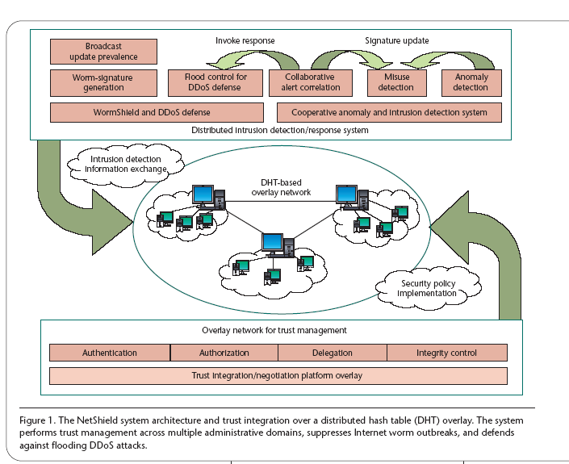
Distributed Security Enforcement over a DHT Overlay Network Developed at the USC
Serious hackers

Slide 45
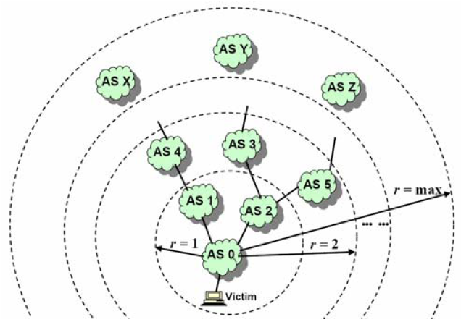
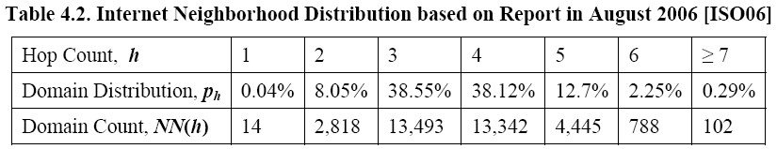
Internet Domain Analysis
Inside the domain, O(N)
For inter-domain, it depends on the topology
Maximum r = 6

Slide 46
Distributed DoS (DDoS) Attacks
Z
H
Z
Z
Attacker
Victim
Z
Z
Z
Z
Z
Z
Attacker infiltrates hosts and commands a handler (H)
Handler sends commends to zombies (Z)
Zombies attack the victim, damages to CPU/Memory resources and to the network bandwidth resources

Slide 47
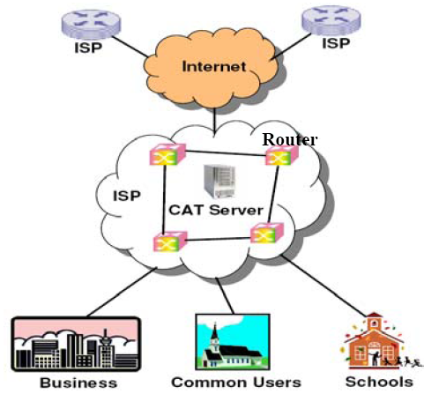
Collaborative Detection Scheme
Routers monitor the traffic and periodically report the individually observed pattern to the central CAT server
The central CAT server analyzes the collected patterns and try to construct a CAT tree
Once a CAT tree formed, we can detect the starting of a DDoS flooding attack
Notes:
Resist approach is not cost effiective
Not amenable to COTS & legacy systems
Does not work for insider threat and Life Cycle Attacks
Identify attacks amenable to cost-effective resistance
Tolerate the rest
Tolerance mechanisms must stay ahead of attackers
Functionality, performance and security must be traded off in real time
Identify Attacks amenable to cost-effective resistance
Tolerate the rest
Tolerance mechanisms must stay ahead of attackers
Functional, performance & security must be traded off in real-time

Slide 48
Distributed Change-Point Detection
Notes:
From Computer Magazine

Slide 49
DETER Testbed for Internet Simulation
DETER Testbed built at USC/ISI and UC Berkeley, funded by the US NSF and DHS

Slide 50
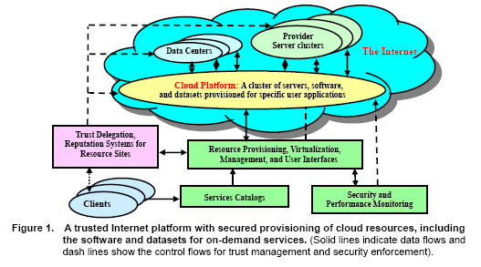
Cloud and Data Security and Copyright Protection
Source: S. Song, K. Hwang, R Zhou, and Y.K. Kwok, “Trusted P2P Transactions with Fuzzy Reputation Aggregation”, IEEE Internet Computing, Special Issue on Security for P2P and AD Hoc Networks, Vol.9, Nov/Dec. 2004.

Slide 51
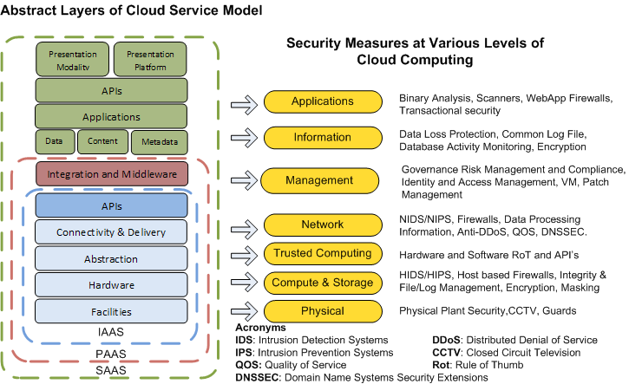
Cloud Service Models and Their Security Demands
Source: K. Hwang and D. Li, “ Trusted Cloud Computing with Secure Resources and Data Coloring”, IEEE Internet Computing, Vol.14, Sept. 2010.

Slide 52
CSA (Cloud Security Alliance): Top Ten Big Data Security and Privacy Challenges
Secure computations in distributed programming frameworks
Security best practices for non-relational datastores
Secure data storage and transactions logs
End-point input validation/filtering
Real time security monitoring

Slide 53
CSA Top Ten Big-Data S/P Challenges
Scalable and composable privacy- preserving data mining and analytics
Cryptographically enforced access control and secure |communication
Granular access control
Granular audits
Data provenance

Slide 54
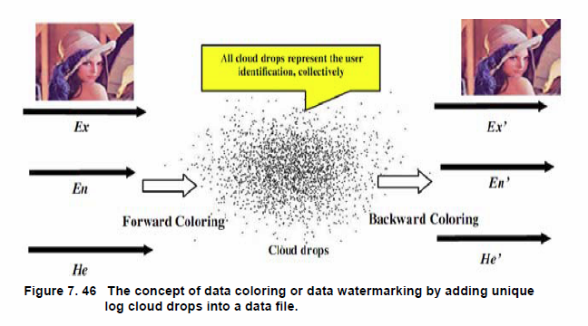
Data Coloring for Privacy Protection on The Cloud
Source: K. Hwang and D. Li, “ Trusted Cloud Computing with Secure Resources and Data Coloring”, IEEE Internet Computing, Vol.14, Sept. 2010.

Slide 55
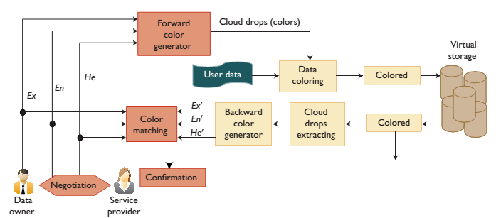
Data Color Matching for owner/user authentication and authorization purposes in a cloud environment

Slide 56
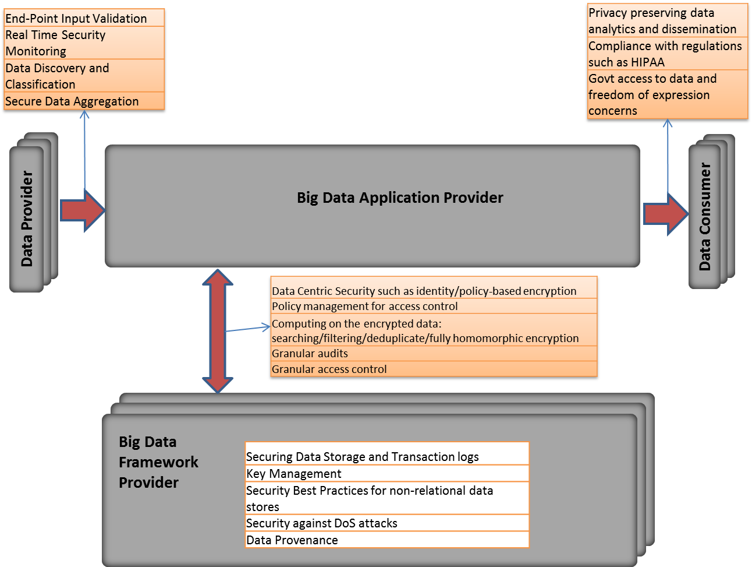
Big Data Security Reference Architecture

Slide 57
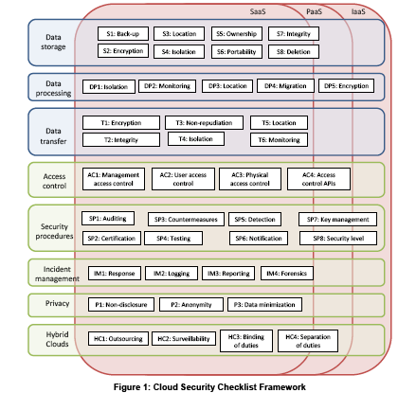
Big Data Security in Clouds

Slide 58
The Future of a Trusted Cloud Computing Environment
Due to economies of scale, a cloud provider can have a dedicated team of security specialists and cloud datacenters have physical protection on par with military installations
Centralized data management also has its benefits —provided that one can manage the risk of data losses, portability issues, etc.
In 2015, 10% of the overall IT security product capabilities will be delivered in the cloud – projection by Telenor Research, October 2013

Slide 59
Security and Trust Barriers in Mobile Cloud Computing
Protecting datacenters must first secure cloud resources and uphold user privacy and data integrity
We suggested the use of a trust overlay network to build reputation systems for trusted cloud computing
A watermarking technique is suggested to protect shared data objects and massively distributed software modules
These techniques safeguard user authentication and tighten the data access-control in public clouds
The new approach could be more cost-effective than using the traditional encryption and firewalls

Slide 60
Concluding Remarks
Scalable killer applications on Cloud/IoT systems
Collaborative Warm Containment in The Internet
DDoS flooding defense over multiple network domains
Copyright protection in P2P content delivery
P2P Reputation Systems for Cloud/Web Services
Trusted Zoning for VM Clusters in Public Clouds
Big Data Analytics for Security Alert Systems

